Slide 1


AI Handwriting Classification Using CNN & Transfer Learning
This presentation covers an AI model that classifies handwriting and identifies writers. It uses CNNs and Transfer Learning (VGG16) for accurate results.

Slide 2
Problem & Objective
Objective
Develop an AI-based handwriting classification system
using CNN & Transfer Learning.
Improve accuracy using data augmentation and hyperparameter tuning.
Problem
Time-consuming and error-prone
Difficult to classify accurately

Slide 3

Dataset Description
Handwritten samples from different individuals
Total images: 698
Classes (writers): 5
Balanced distribution across classes

Slide 4
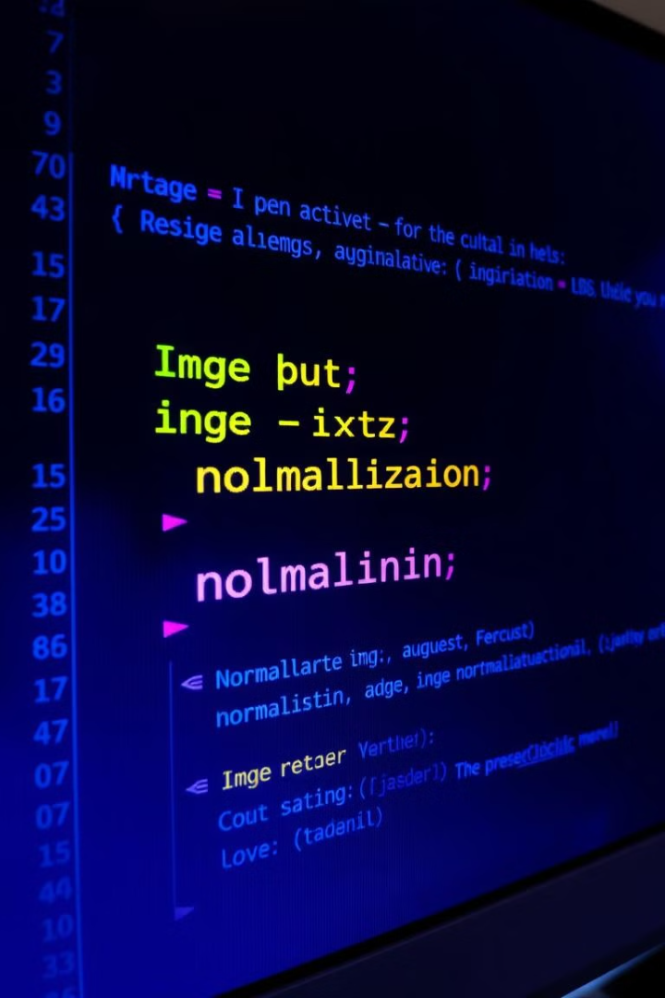
Data Preprocessing & Augmentation
Resizing
Uniformity: 128x128 pixels
Normalization
Pixel values scaled between 0-1
Augmentation
Rotation, shifting, shearing, zooming, flipping

Slide 5






Model Architecture (CNN)
Convolutional layers
Feature extraction
Batch normalization
Speeds up training
Max pooling
Feature preservation
Dropout
Prevents overfitting
Dense layers
Classification
Softmax activation
Probability distribution

Slide 6
Model Architecture (VGG16)
Pretrained VGG16
Global average pooling
Fully connected layers
Frozen base layers for efficient training
Dimension reduction
Dense layers, dropout, softmax output

Slide 7

Model Compilation & Training
1
Adam optimizer: adaptive learning rate
2
Categorical crossentropy loss: multi-class classification
3
Accuracy metric: performance evaluation
4
Training details: 20 epochs for each model, with validation

Slide 8
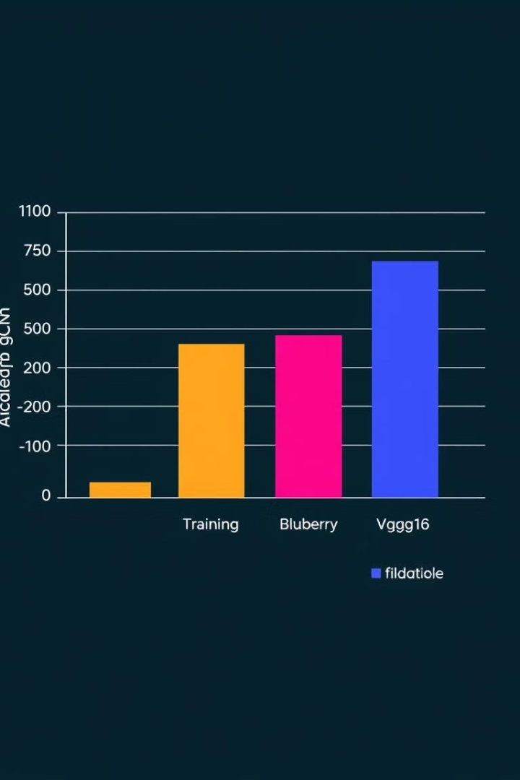
Results & Evaluation
CNN (Custom)
78.75%
22.22%
VGG16 (Transfer Learning)
85.58%
96.49%

Slide 9

Business Impact & Conclusion
Automated writer identification: saves manual effort, reduces errors
Improved accuracy: CNN & Transfer Learning enhance handwriting recognition
Security & authentication: forensics, document verification, exams
Cost-effective: automates handwriting classification for large-scale applications

